Slide 1
Visual simulator for high quality planning domain models
Software Engineering 2: Project Teamwork Mälardalen University
Group #2
Client : Ericsson
Contact : Swarup Kumar Mohalik

Slide 2
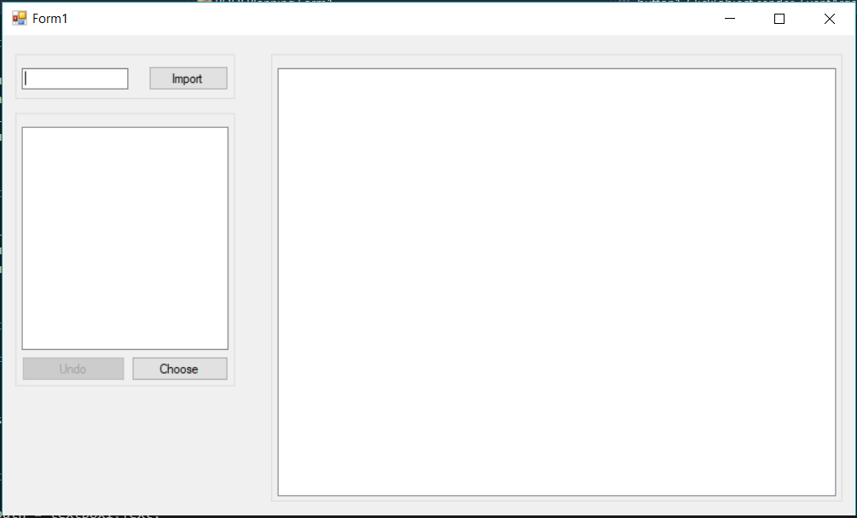
What we did last week
Created mockup version of the tool

Slide 3
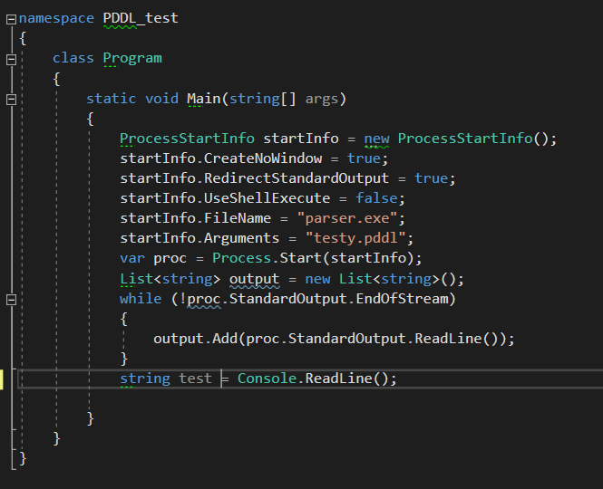
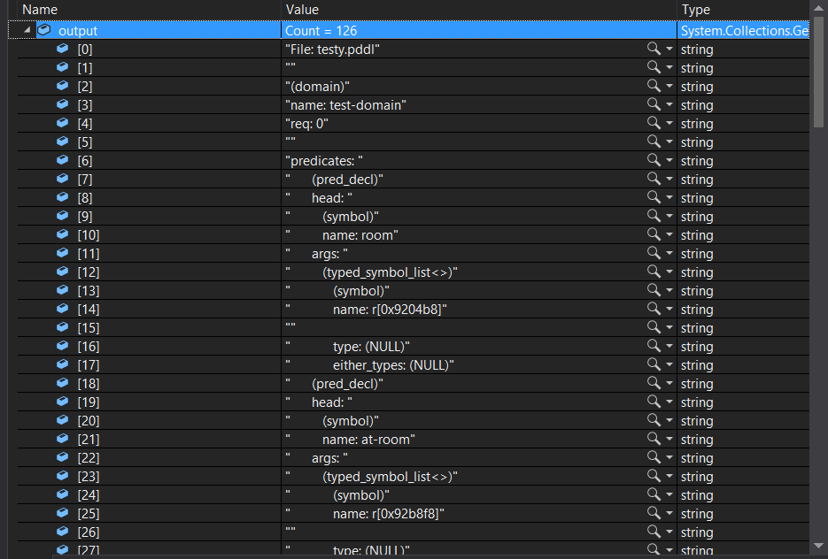
What we did last week
Attempt to parse PDDL using the VAL tool

Slide 4
What we did last week
Corrected the project plan
Visualized PDDL code with Finite-state machine

Slide 5
Unfinished items from last sprint
We planned on using Latex, but went instead with Google docs because of time limit

Slide 6
Encountered problems
Lack of documentation for the VAL tool
In order to continue implementation we need to be able to parse PDDL using the VAL tool

Slide 7
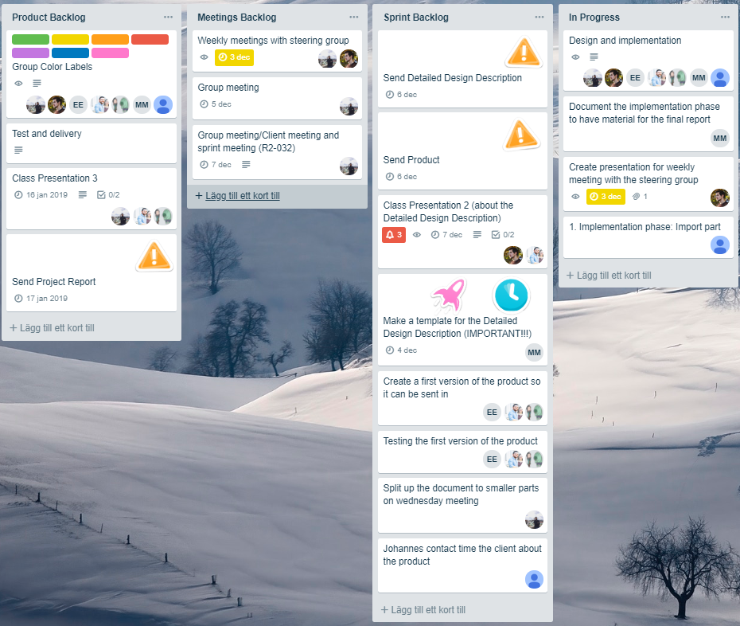
What are we doing this week

